Slide 1
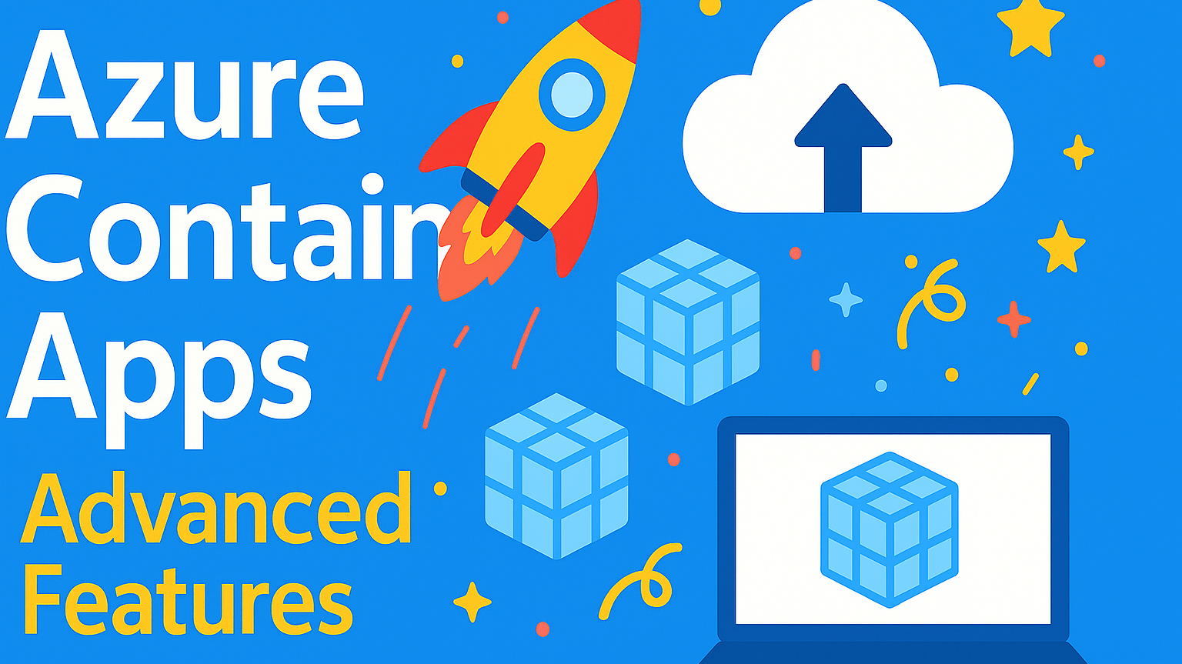

Slide 2

Agenda
Scaling
Split Traffic
Custom DNS
Network Configuration
Integration with Other Azure Services

Slide 3

Scaling Options
CPU/Memory based
HTTP requests
Queues (Azure Service Bus, Storage Queues)
Custom metrics

Slide 4
Scaling Example
az containerapp update --name my-app --resource-group my-containerapps-group --scale-rule-name http-rule --scale-rule-type http --scale-rule-http-concurrency 50

Slide 5

Network Configuration
Ingress options: internal vs external
VNET integration (Preview)
IP restrictions
Custom domains

Slide 6
Secrets
Store secrets in Azure
Access using environment variables
az containerapp secret set --name my-app --name my-containerapps-group --name my-secret=supersecurevalue

Slide 7
Using Secrets in App
az containerapp update --name my-app --resource-group my-containerapps-group --env-vars SECRET_VAR=secretref:my-secret

Slide 8

Integration with Azure Services
Azure Monitor
Azure Key Vault
Azure Container Registry
Azure Functions and Logic Apps

Slide 9

Event-driven Architectures
Use Dapr for pub/sub, state management
Integrate with Event Grid

Slide 10


Advanced Features
Demo
Custom DNS, Scaling, Split Traffic

Slide 11

Summary
Explored advanced features such as auto-scaling based on metrics, secure networking configurations, and managing secrets in Azure.
Learned how to integrate Azure Container Apps with services like Azure Monitor, Key Vault, and Event Grid to build robust, event-driven applications.
Next steps: Explore Microsoft Learn paths and Azure documentation for deep dives into production deployments and CI/CD strategies.

Slide 12
Resources
Azure Container Apps documentation
https://learn.microsoft.com/en-us/azure/container-apps/

